Slide 2
Treasure Hunting in
Azure with
KQL as Your Map
Emanuel Palm
Cloud Specialist @ Unwonted

Slide 3


What’s a pirate’s favorite Azure service? 🏴‍☠️

Slide 4

A
R
G

Slide 5

Azure Resource Graph
A
R
G
Explorer
Query the Azure management plane
Across management groups and subscriptions
Uses Kusto Query Language (KQL)
A subset of the KQL supported by Azure Monitor/Log Analytics, Data Explorer, Sentinel
Based on Azure RBAC with your own permissions
Flexible usage through tooling

Slide 6
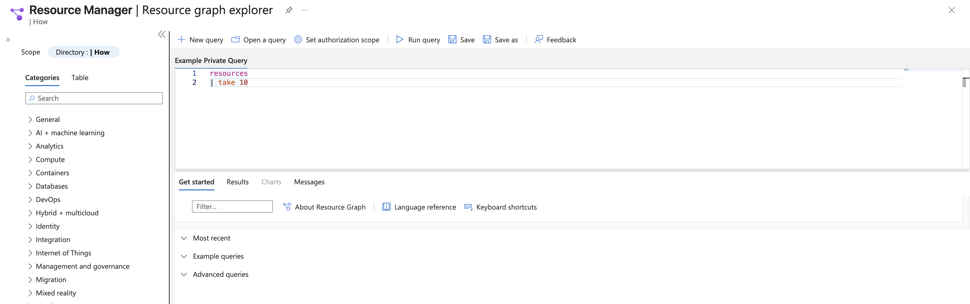
Azure Resource Graph
Explorer

Slide 7
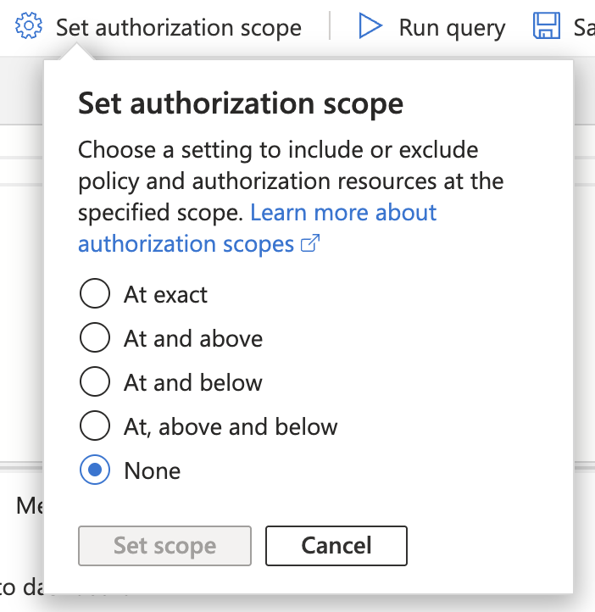
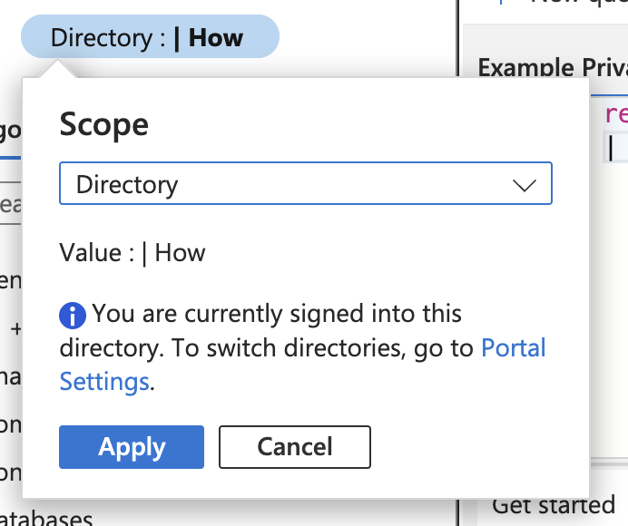
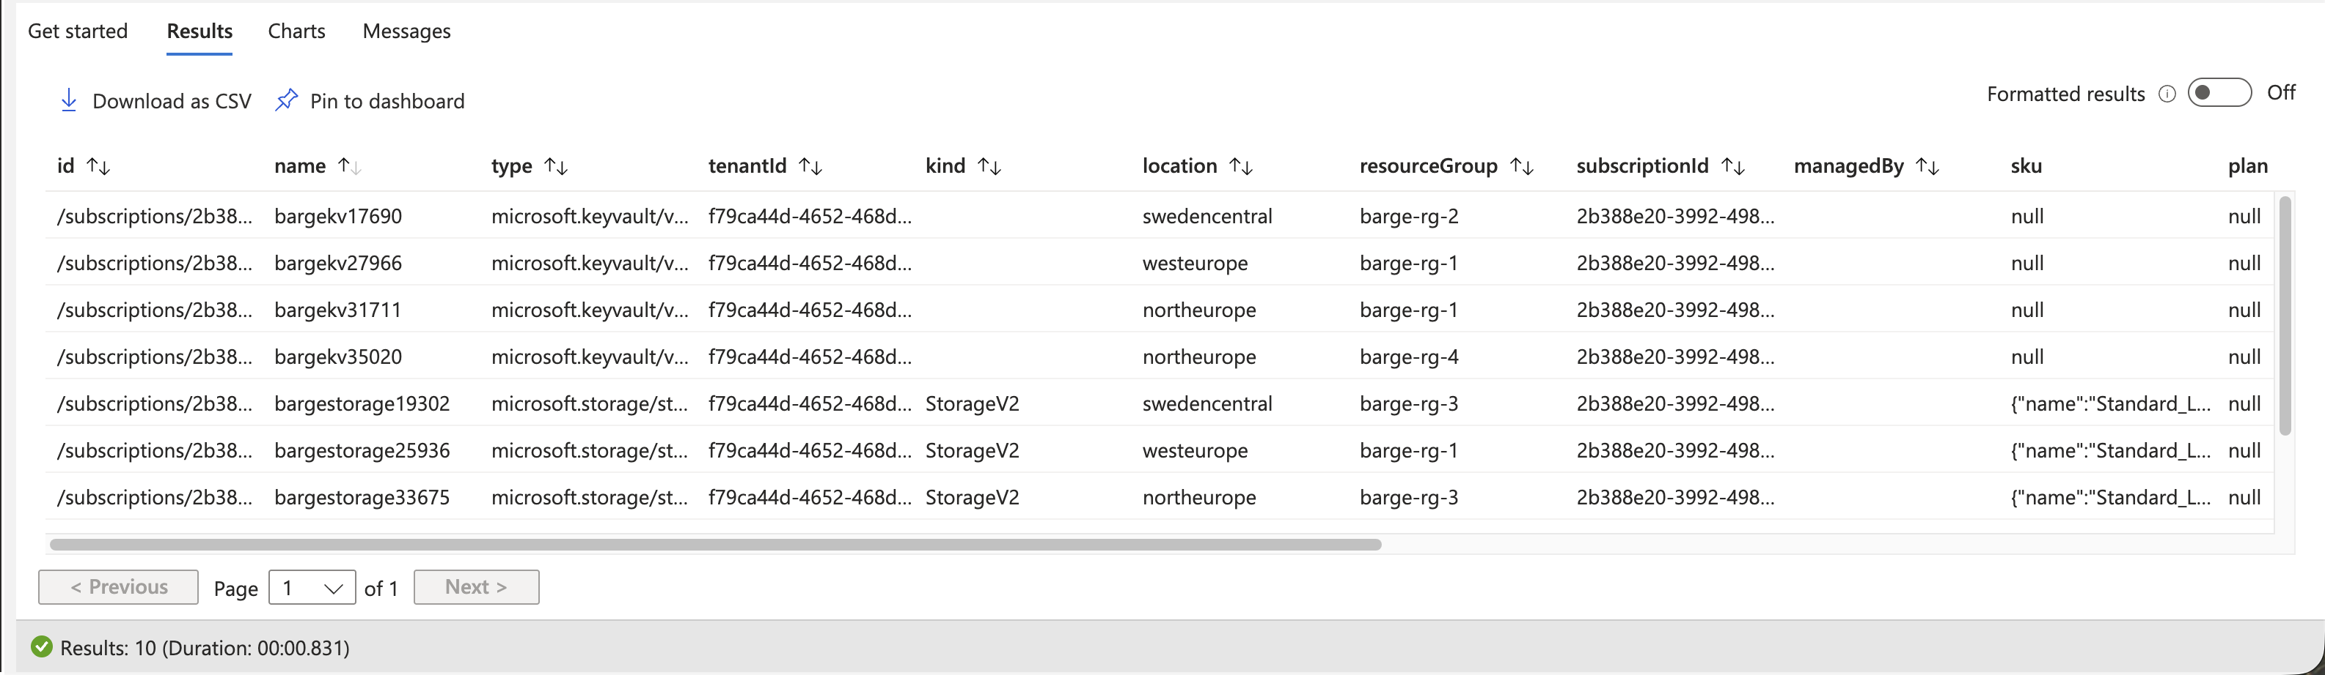
Azure Resource Graph
Explorer

Slide 8



Azure Resource Graph
boosted
Explorer

Slide 9
Azure Resource Graph
boosted
Explorer

Slide 10
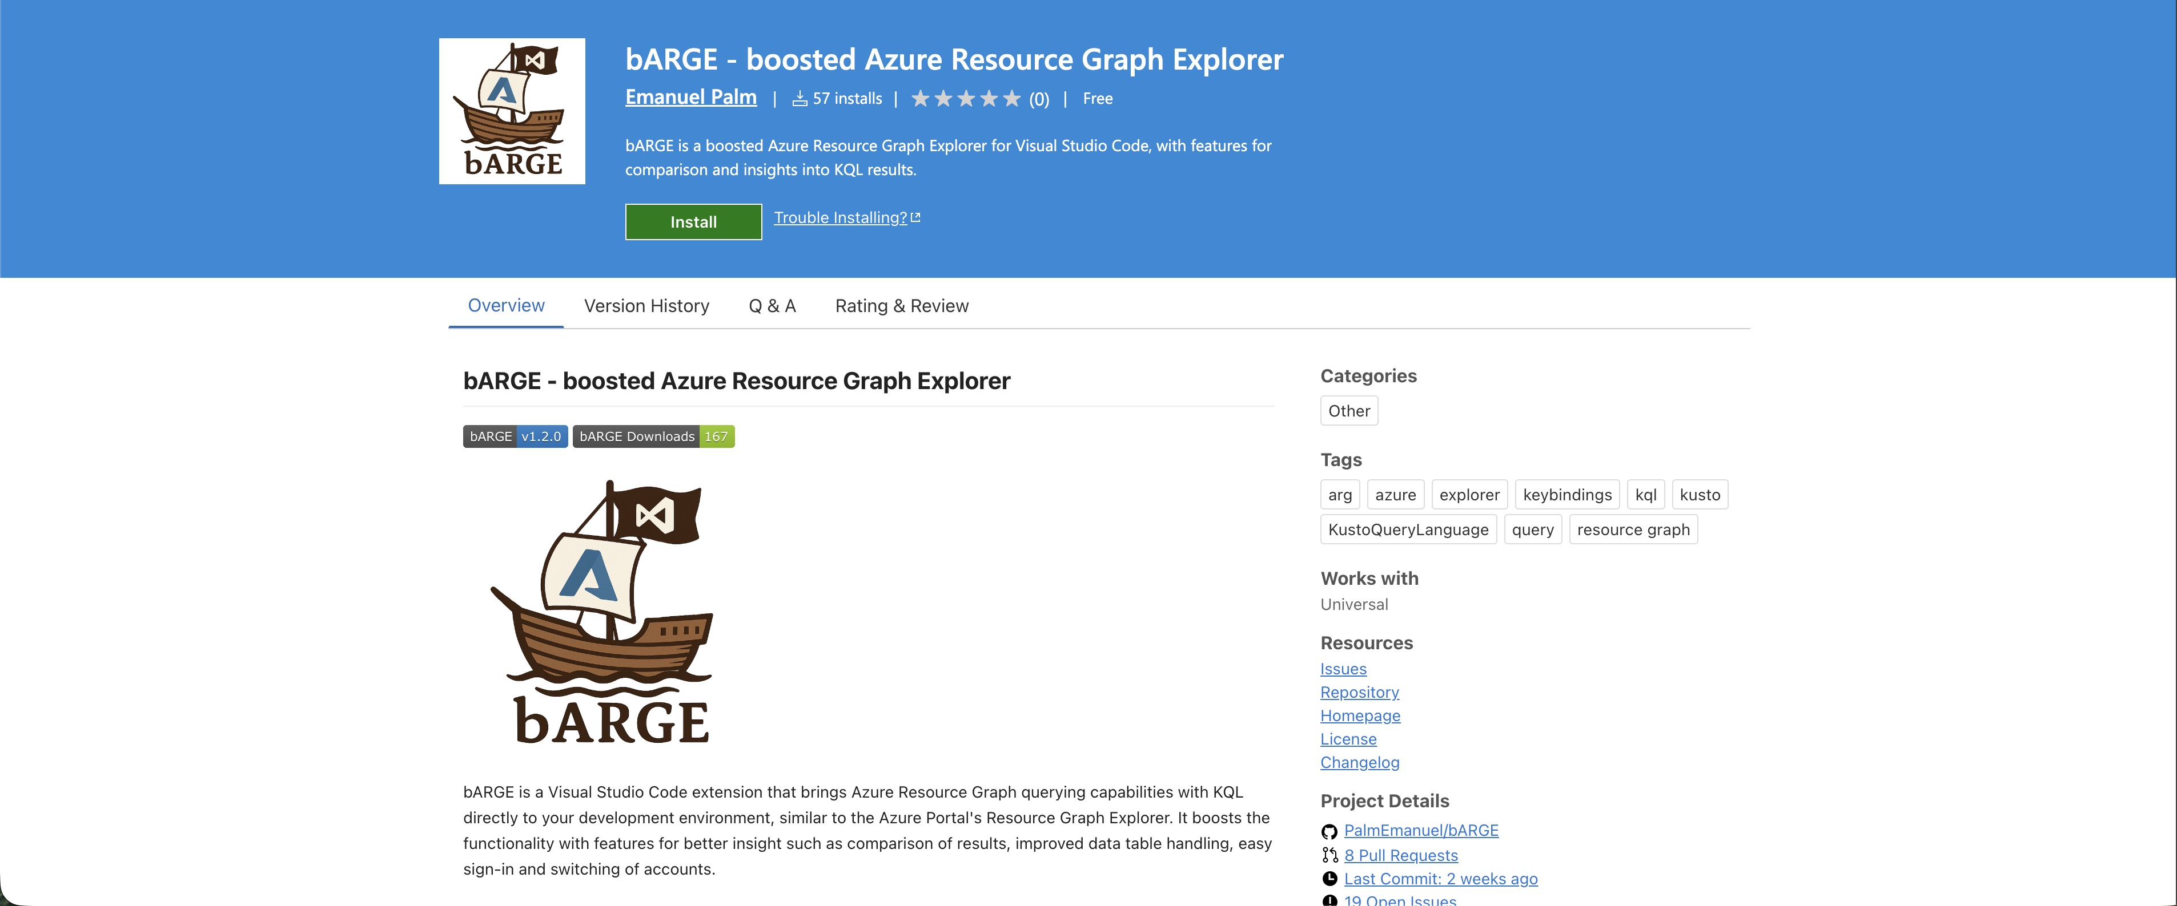

Slide 11






Emanuel Palm
💙 Everything-as-Code
📦 Makes modules & tools
📃 Fan of Open Source
☁️ Blogs at pipe.how
☕️ Roasts coffee at arkanum.coffee
🇸🇪
Cloud Specialist @ Unwonted Microsoft MVP - Azure
@PalmEmanuel

Slide 12



Ways to use Azure Resource Graph
Azure Portal
PowerShell & CLI
REST API
VS Code

Slide 13
ARG KQL Syntax
Tables
ResourceContainers
AuthorizationResources
PolicyResources
Functions
tostring()
isnotempty()
rand()
Resources
)
not(
Operators
project
join
Keywords
or
by
on
where
and
and
contains

Slide 14
Example Query
| type == 'microsoft.keyvault/vaults’
name 'kv’
tags['env'] == 'prod'
Resources
where
and
contains
and
not(
)

Slide 15
Example Query
| type == 'microsoft.keyvault/vaults’
name 'kv’
tags['env'] == 'prod'
Resources
where
and
contains
and
not(
)

Slide 16
Example Query
| type == 'microsoft.keyvault/vaults’
name 'kv’
tags['env'] == 'prod'
Resources
where
and
contains
and
not(
)

Slide 17

Querying ARG Demo

Slide 18







Sharing Queries
Resource Graph Queries
Git Repository
Log Analytics Query Packs *
.KQL files
Microsoft.ResourceGraph/queries
Microsoft.OperationalInsights/queryPacks/queries
*ish

Slide 19
Tips & Tricks
The Resources table is the default, no need to specify it
Hidden SystemData property for resource metadata
If supported by the resource – Check API version
Shared queries can be used inside queries with {{ }} syntax
You can use ARG from Log Analytics with arg(“”).Resources
But not yet* with bARGE
*may be added if it’s reasonable
Notes:
https://learn.microsoft.com/en-us/azure/governance/resource-graph/concepts/query-language#resource-graph-tables
https://learn.microsoft.com/en-us/azure/azure-monitor/logs/azure-monitor-data-explorer-proxy#query-data-in-azure-resource-graph-by-using-arg-preview
https://learn.microsoft.com/en-us/azure/azure-monitor/logs/azure-monitor-data-explorer-proxy#azure-resource-graph-cross-service-query-considerations
https://learn.microsoft.com/en-us/azure/governance/resource-graph/concepts/query-language#resource-graph-custom-language-elements

Slide 20
Alerts with Azure Resource Graph
Don’t forget Azure Policy
Alerts are reactive
Examples of potentially interesting ARG alerts
FinOps – Someone creates allowed, but high-cost resources
Operational – ResourceChanges in sensitive scopes
Security – Resource-related events, permissions and roles
Alerts need access permissions for ARG
Limitations
Cannot join multiple ARG tables, union works
Only 1000 records
Notes:
https://learn.microsoft.com/en-us/azure/azure-monitor/logs/azure-monitor-data-explorer-proxy#query-data-in-azure-resource-graph-by-using-arg-preview
https://learn.microsoft.com/en-us/azure/azure-monitor/logs/azure-monitor-data-explorer-proxy#azure-resource-graph-cross-service-query-considerations

Slide 21
Alerts with ARG Demo

Slide 22


Limitations
1000 records per query response
Implement pagination
15 queries / 5 seconds / User
x-ms-user-quota-remaining
10 000 subscriptions limit for wide queries

Slide 23

ARG GET/LIST API
4000 queries / Minute / User / Subscription
Redirect ARM API requests to ARG
&useResourceGraph=true
&useResourceGraph=true
https://management.azure.com/subscriptions/{subscriptionId}/resourceGroups/{resourceGroup}/providers/{providerNamespace}/{resourceType}/{resourceName}?api-version={apiVersion}
Notes:
https://learn.microsoft.com/en-us/azure/governance/resource-graph/concepts/azure-resource-graph-get-list-api

Slide 24

Azure Resource Graph in Dashboards

Slide 25
Dashboards with ARG Demo

Slide 26
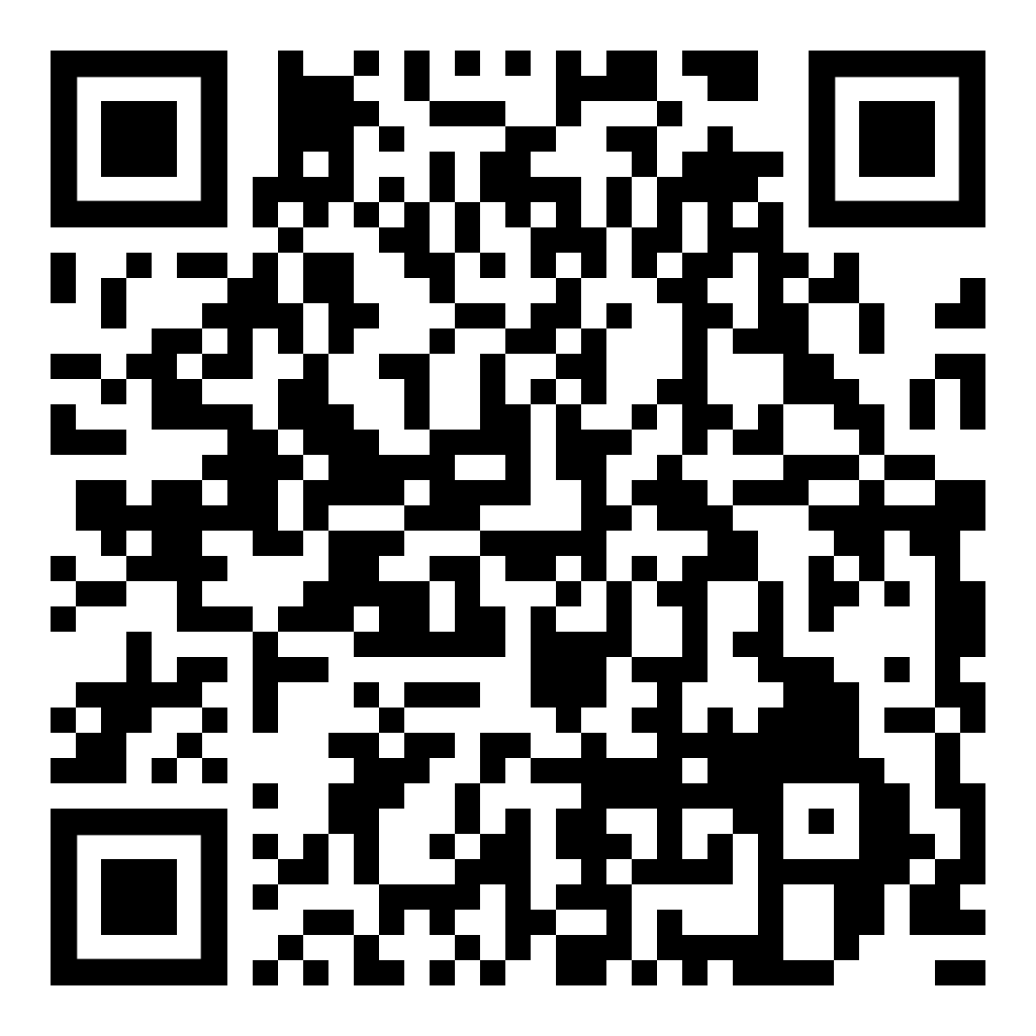
Install bARGE here!
Key Takeaways
Navigate the cloudy sea
ARG lets you query at scale
Find hidden treasures
Identify differences, misconfigurations, details
Hoist your sails anywhere
Use from Portal, VS Code (bARGE), CLI, dashboards, alerts and more
Emanuel Palm
Reach out!
Cloud Specialist @ Unwonted
@PalmEmanuel

